Slide 1
Machine Learning for SQL Injection Prevention on Server-Side Scripting

Slide 2
hello!
I am Ajaykumar Majukar
I am here because I love to give presentations.
You can find me at @ www.linkedin.com/in/ajaymajukar

Slide 3
CONTENTS
Abstract
Introduction
Literature Survey
Explanation of the Paper
Conclusions
Seminar Learning Outcomes
Important References

Slide 4
Abstract
Develop a framework of SQL injection prevention using
compiler platform and machine learning

Slide 5
SQL injection vulnerability can be generated unintentionally by software developer during the development phase. To ensure that all secure coding practices are adopted to prevent the vulnerability.
The framework of SQL injection prevention using compiler platform and machine learning is proposed. The machine learning part will be described primarily since it is the core of this framework to support SQL injection prediction by conducting 1,100 datasets of vulnerabilities to train machine learning model.
The results indicated that decision tree is the best model in term of processing time, highest efficiency in prediction.

Slide 6

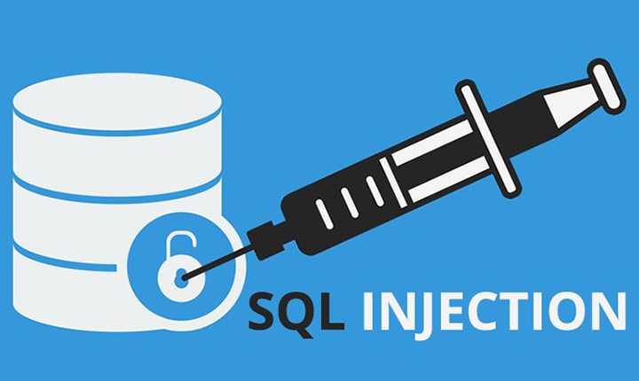
INTRODUCTION
The most common web application vulnerability found in the National Security Agency (NSA) report is SQL injection.
It can be prevented by implementing input sanitization or use personal expertise on coding.
However, web application is still vulnerable if the input sanitization or filtering is not being able to either fulfil or predict the trend of vulnerability over the web application code.

Slide 7
1.
WHAT IS SQL INJECTION ?
Let’s start with a live demonstration of this attack

Slide 8
An SQL injection is a computer attack in which malicious code is embedded in a poorly-designed application and then passed to the backend database.

Slide 9
Literature Survey
S/N | Name of the Paper | Authors | Year of Publication
1 | National Security Agency. (2014, December). Defending Against the Exploitation of SQL Vulnerabilities to Compromise a Network. | N/A | 2014
2 | A novel method for SQL injection attack detection based on removing SQL query attribute values, Mathematical and Computer Modelling. | Lee I., Jeong S., Yeo S., & Moon J. | 2012
3 | Supporting secure programming in web applications through interactive static analysis | Zhu J., Xie J., Lipford H.R., & Chu B. | 2014
4 | Predicting SQL injection and cross site scripting vulnerabilities through mining input sanitization patterns. | Shar L.K. and Tan H.B.K | 2013

Slide 10
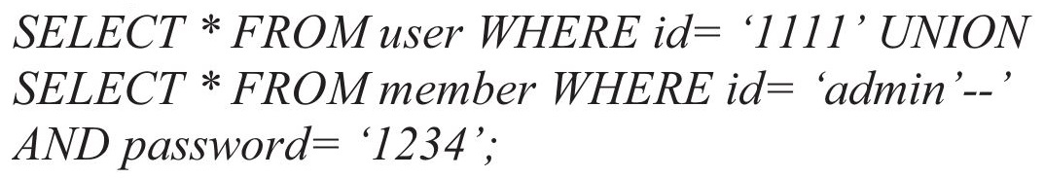
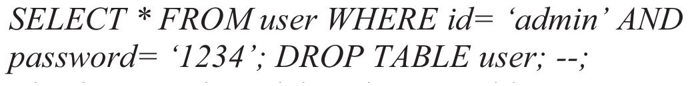
Union Queries
Piggy-Backed Queries

Slide 11
Shar and Tan proposed the framework called “PhpMinerI” for SQL injection (SQLI) and cross site scripting (XSS).
Naïve Bayes (NB), and Multi-Layer Perceptron (MLP) were used to predict and detect the vulnerabilities on eight PHP standard open-source web applications.
MLP algorithms which is supposed to be more effective than traditional testing if the model in machine learning is effectively trained [2].
However, Shar and Tan did not specify the types of SQL injection that their research can resolve
93%
SQL!
78%
XSS!

Slide 12
The process is easy
Datasets Extraction
Defined Machine
Learning Models
Vulnerability Prediction
Validate Syntax

Slide 13
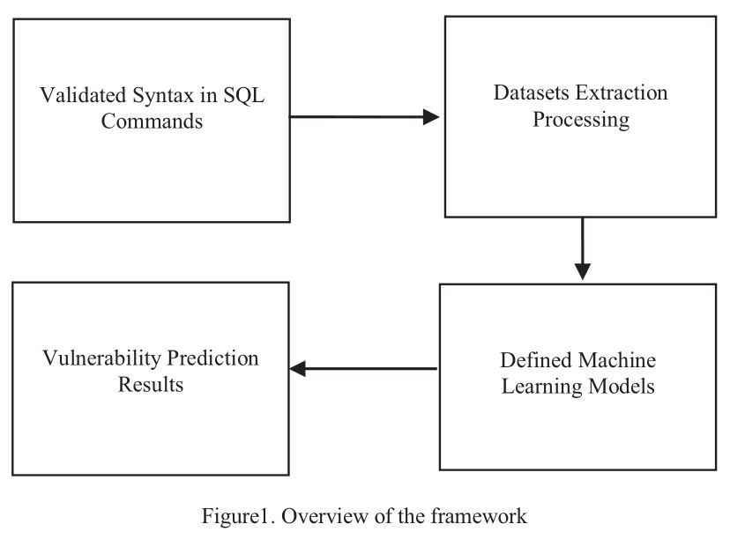

Slide 14


SQL Injection Commands DataSets Extraction
Fixed variable
A fixed variable is a variable that receives value internally within server-side scripts. This type of
variable does not directly involve
with SQL injection.
Dependent variable
A dependent variable is a variable that receives value from user input, thus, there is a possibility that SQL injection

Slide 15
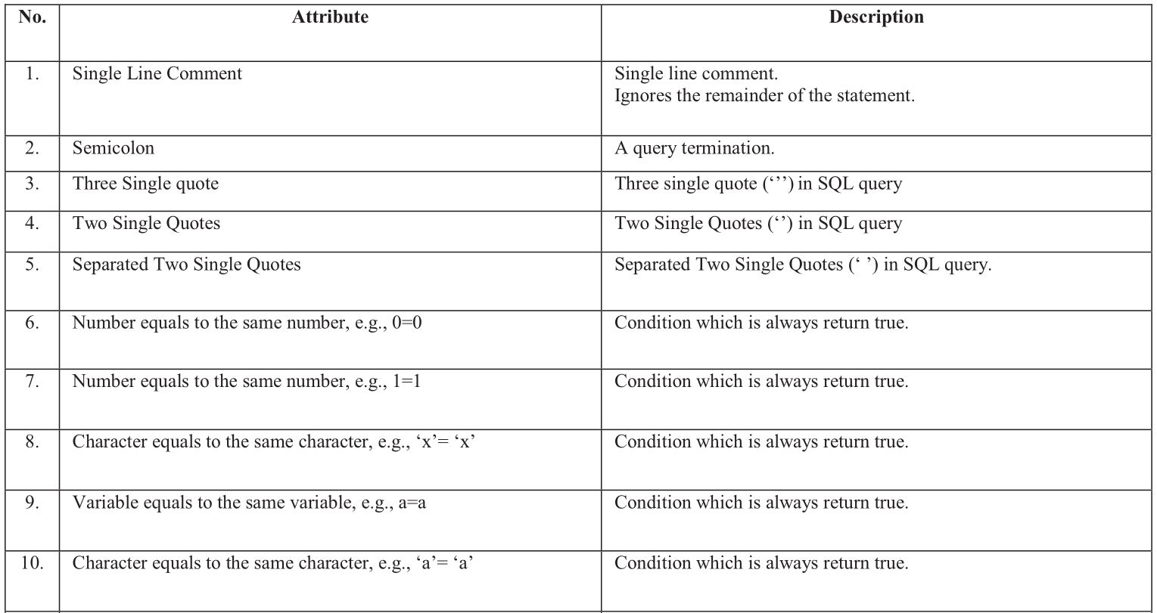

Slide 16
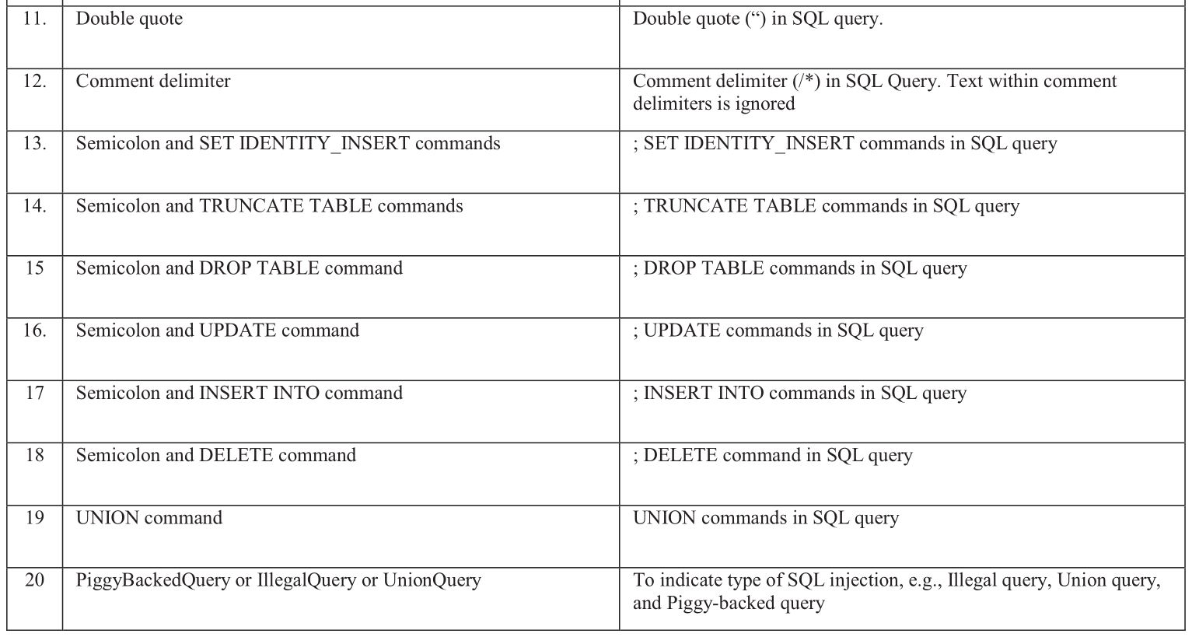

Slide 17
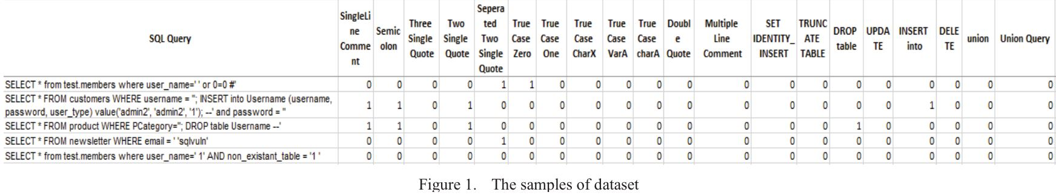
1100
20
samples of vulnerable SQL commands
input attribute

Slide 18
CONCLUSIONS
The goal is to proposed the framework of SQL injection prevention in Illegal/Logically Incorrect Queries, Union Queries, and Piggy-backed Queries on server-side scripting using compiler platform and machine learning.
The machine learning part is described primarily in this paper since it is main core for SQL injection prediction part.
Decision jungle performs as the best machine learning model which has Pd = 0.9955, Pf = 0,
Acc = 0.9968 and Processing Time = 2.4725 Seconds.
Future experiment will be reflected to build the compiler platform on Integrated Development Environment (IDE) which should be able to validate the SQL syntax as well as support prediction and detection the SQL injection using Machine Learning application in server-side scripts within the development phase

Slide 19
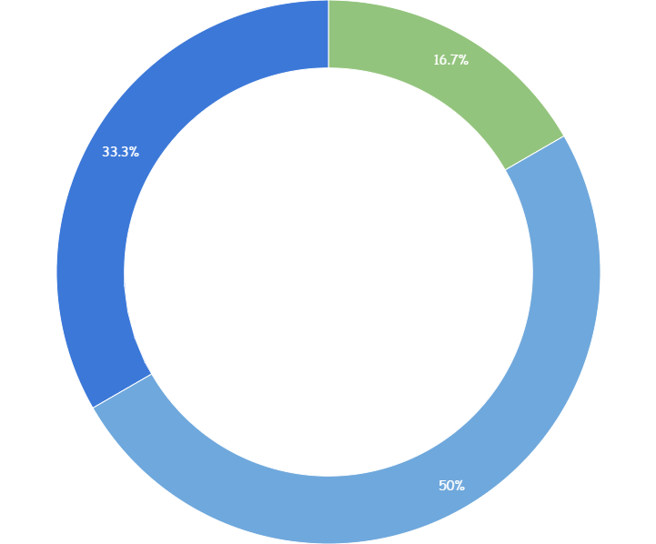


Seminar Learning Outcomes
Presentation Skills
Machine Learning Models & Techniques
Hands On Experience with SQL Injection attacks

Slide 20
IMPORTANT REFERENCES
[1] National Security Agency. (2014, December). Defending Against the Exploitation of SQL Vulnerabilities to Compromise a Network. Available: https://www.iad.gov/iad/library/ia-guidance/tech-briefs/defending-against-theexploitation-of-sql-vulnerabilities-to.cfm.
[2] Lee I., Jeong S., Yeo S., and Moon J., A novel method for SQL injection attack detection based on removing SQL query attribute values. Mathematical and Computer Modelling, 55(1–2), 2012, pp. 58-68.
[3] Zhu J., Xie J., Lipford H.R., and Chu B., Supporting secure programming in web applications through interactive static analysis. Journal of Advanced Research, 5(4), 2014, pp. 449-462.
[4] Shar L.K. and Tan H.B.K., Predicting SQL injection and cross site scripting vulnerabilities through mining input sanitization patterns. Information and Software Technology, 55(10), 2013, pp. 1767-1780.

Slide 21
thanks!
Any questions?
You can find me at
ajaymajukar@gmail.com

